Slide 1

Software Engineering – Process & Tools
Team P09 - 05

Slide 2



Team: Group-P09-05
Francis Zaldarriaga
Renato Alvarez
David Pham
Sandesh Mangat
Riveen Perera
Esmatullah Akhtary

Slide 3
Agenda
Project Overview
Sign up and sign in users.
Appointment booking
Profile page
Pet registration
Appointment management
Medical Records
Prescriptions
Saved Resources
Educational resources
Prescription tracking
Project Retrospect

Slide 4
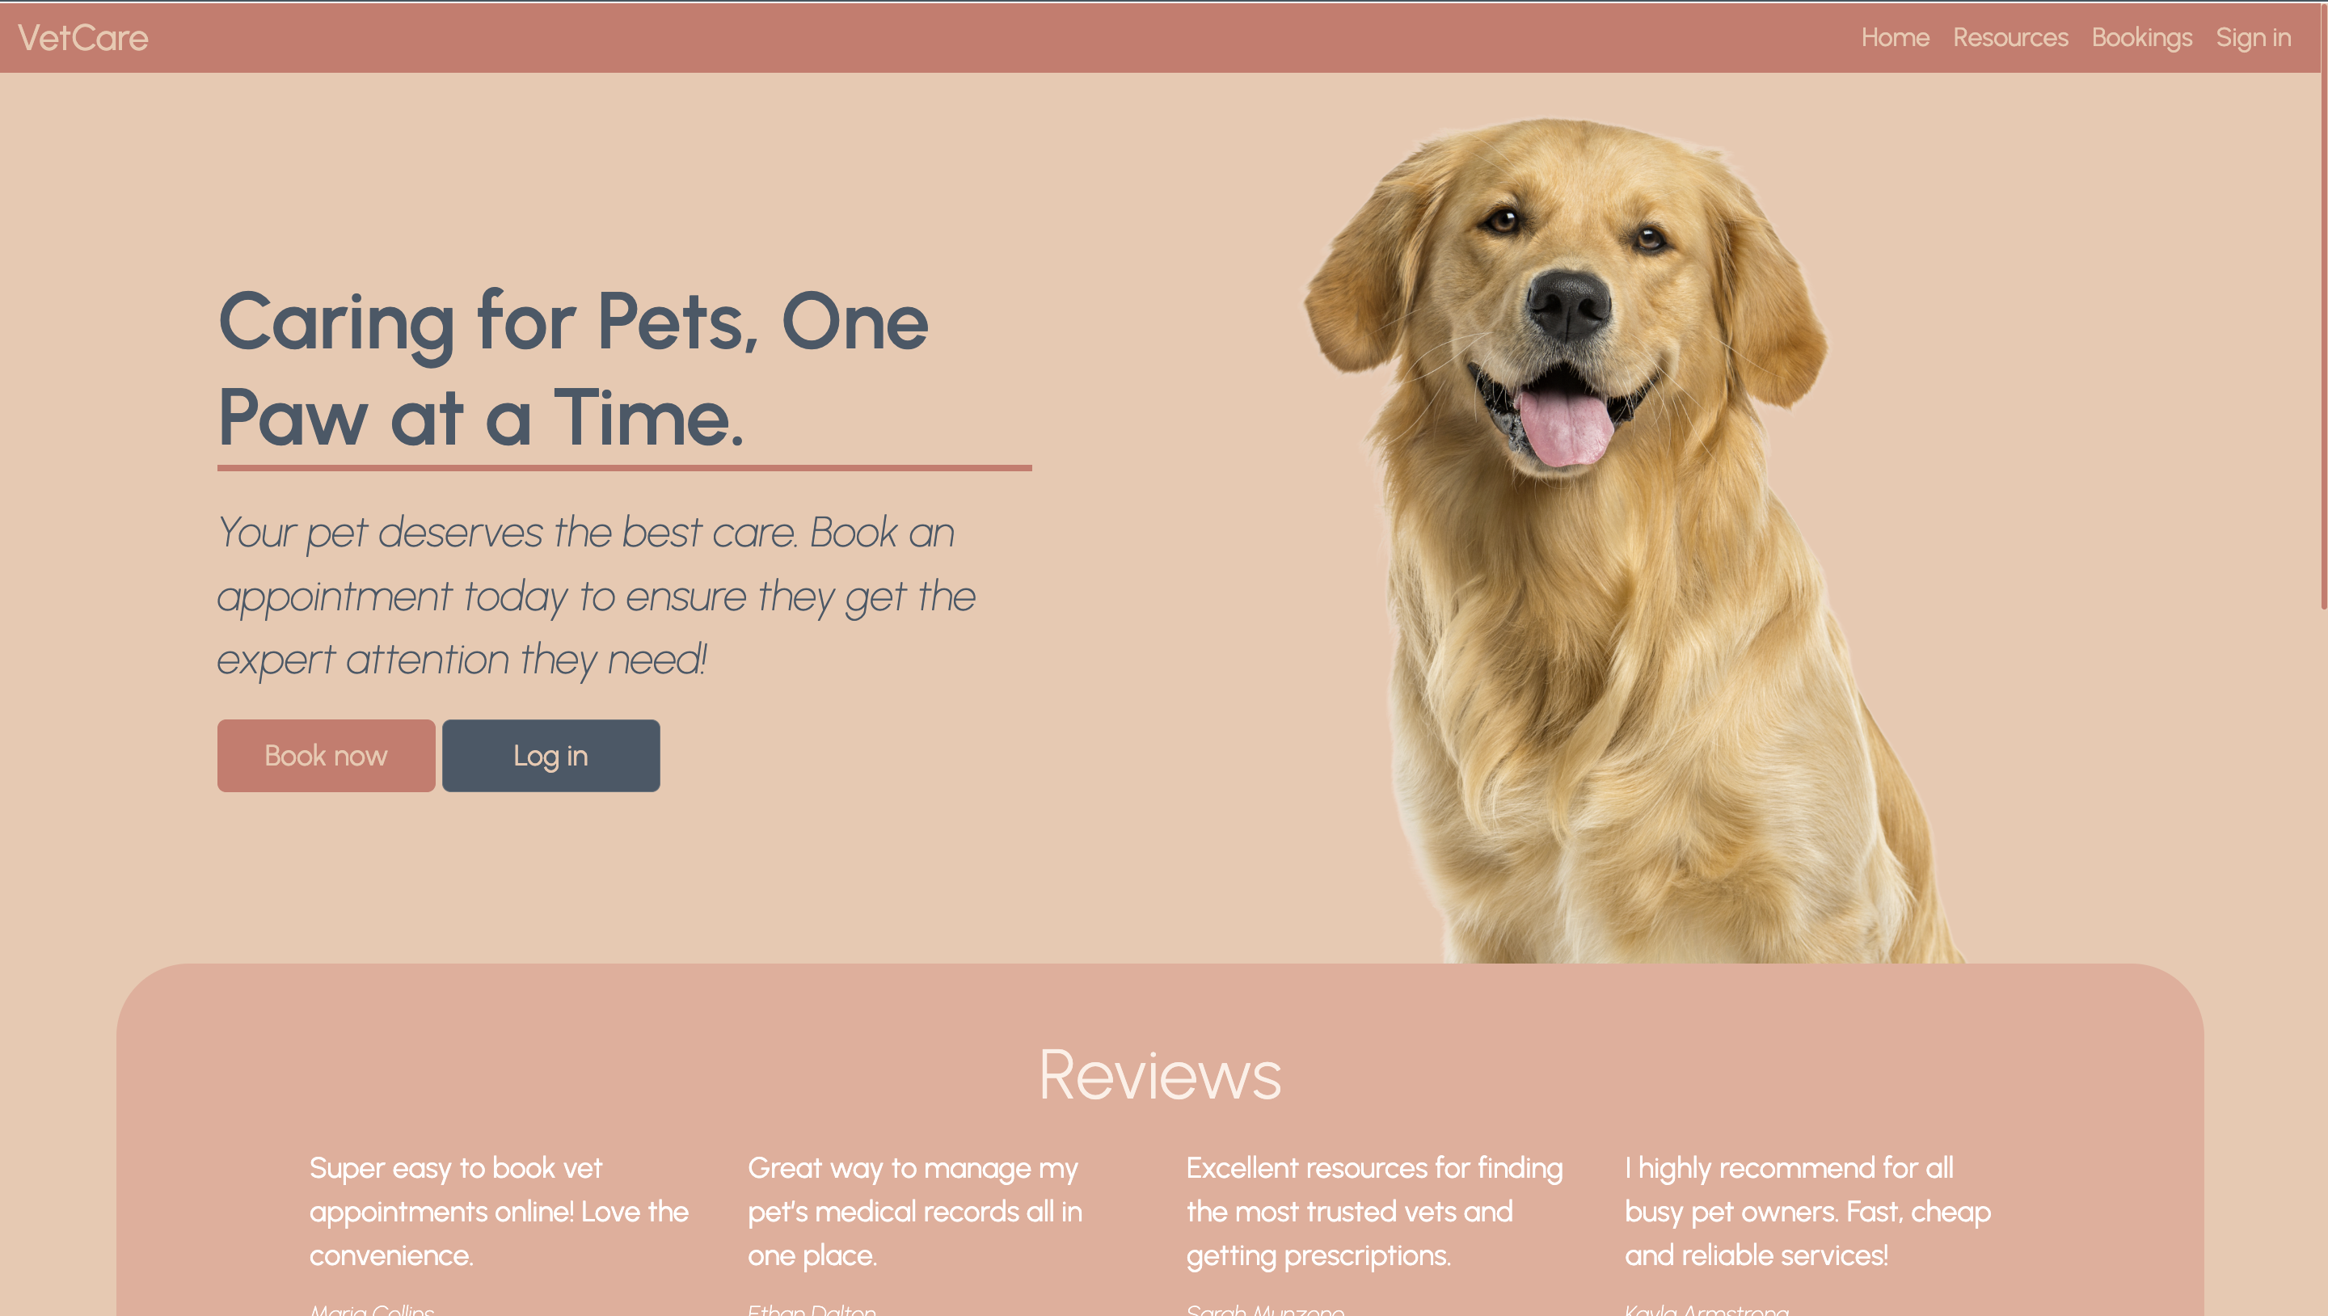
Project Overview
Pet healthcare management system
Includes appointment bookings, prescriptions, medical records, pet registration and resources
3-tiered monolithic architecture
Presentation, Business Logic & Data Tier layers

Slide 5
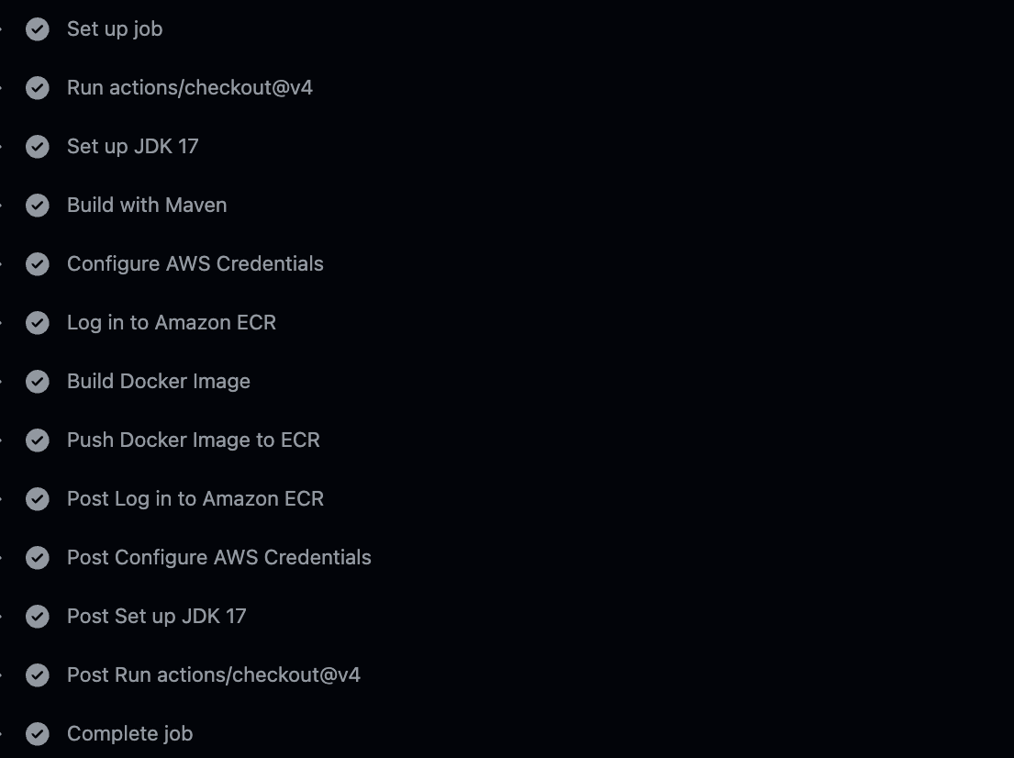
CI/CD Workflow
Checkouts repo at commit that triggered workflow
Sets up JDK
Runs maven build
Configures AWS credentials & logs in
Builds and Pushes Docker Image to ECR

Slide 6
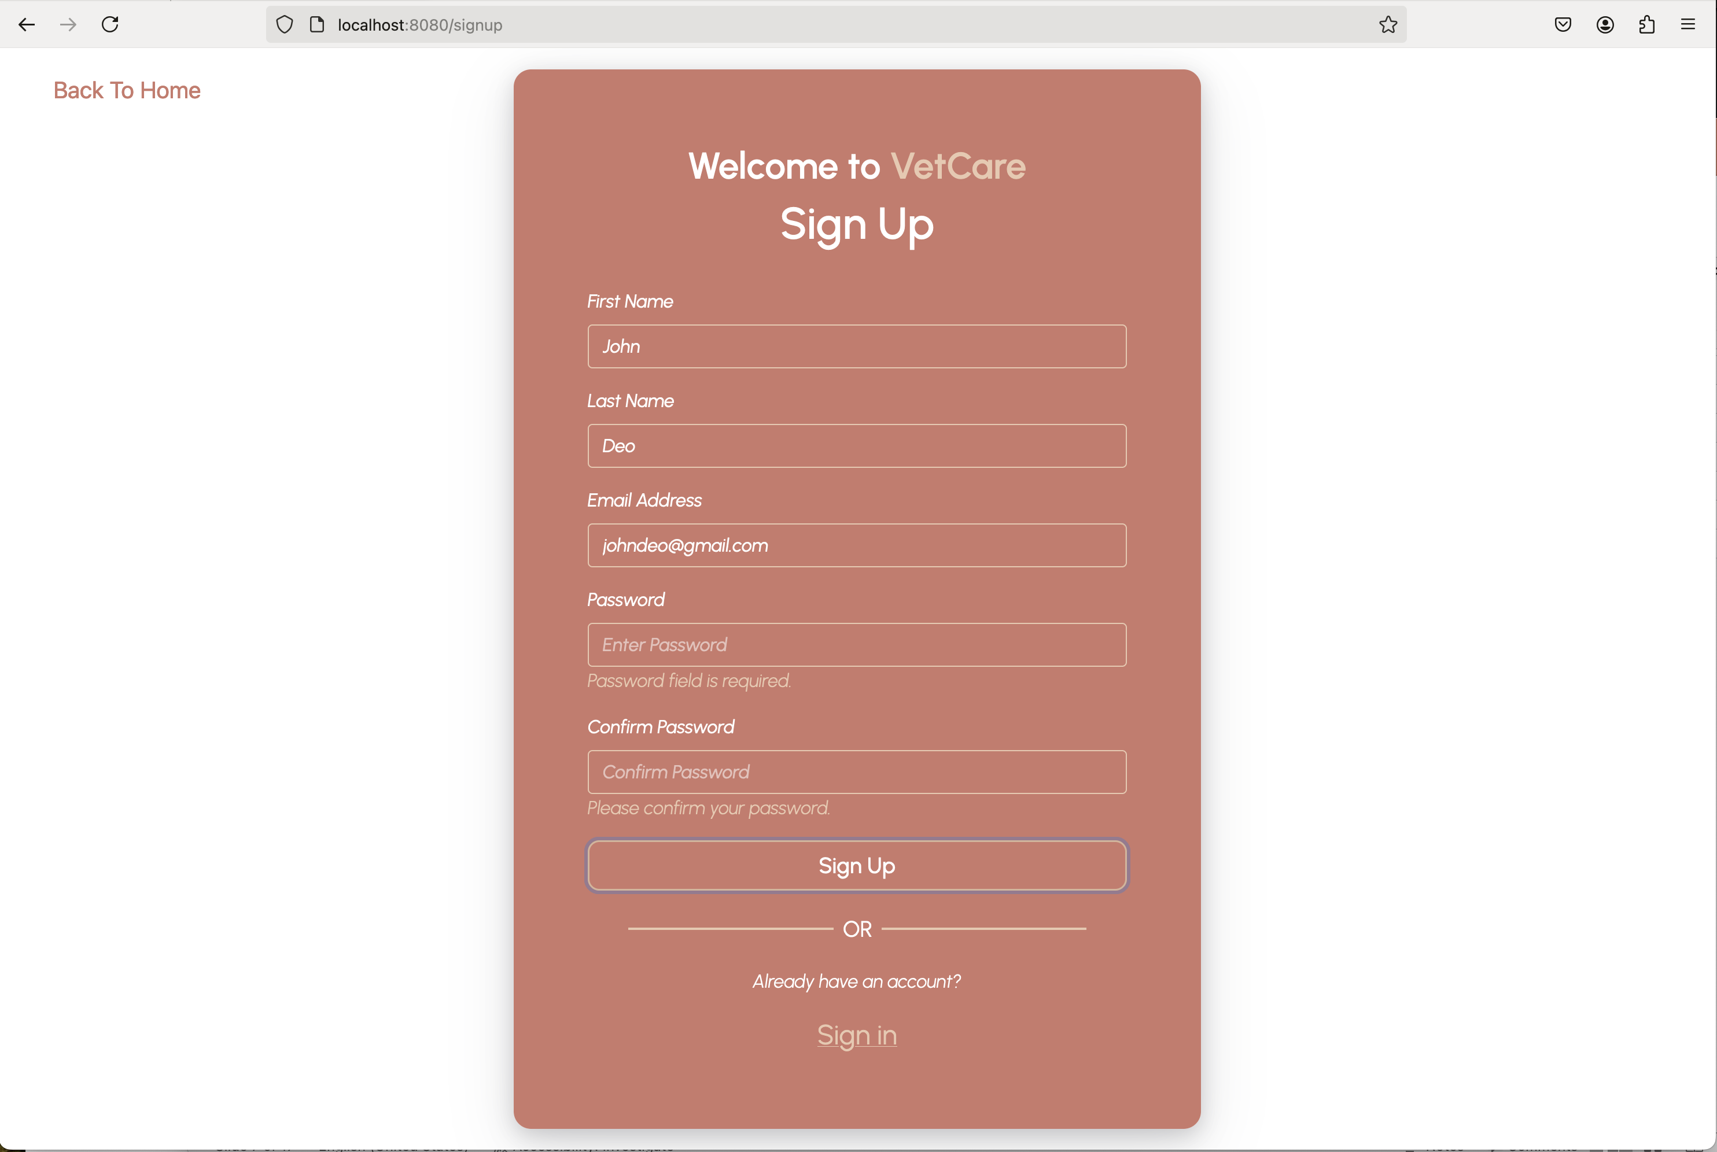
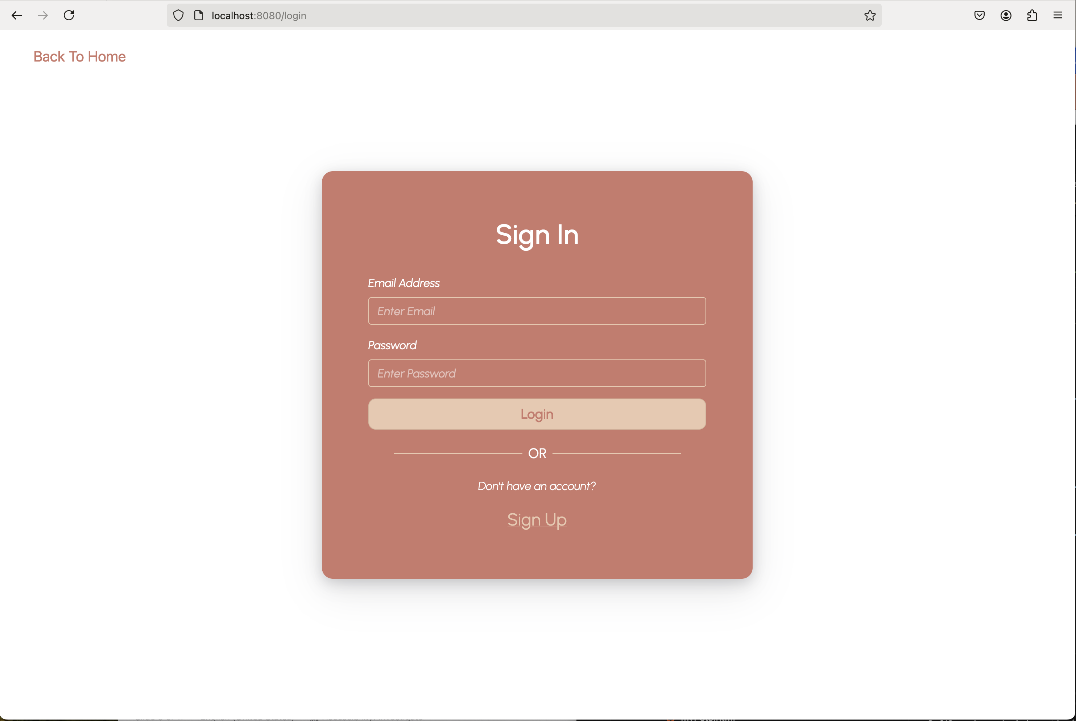
Sign Up & Sign In Functionality
New User Registration: The signup page allows new users to create an account by providing essential details like name, email, and password.
Password Validation: The password field typically includes validation for strength, ensuring users choose a secure password. Password should be at least 8 characters containing uppercase, lowercase, numbers, and symbols.
Form Submission: After filling out the form, users can submit the information to create their account.
Error Messages: If there are validation issues, such as an invalid email or weak password, error messages will be displayed to guide the user in correcting their input.
Successful Registration: After filling out the form, and submitting it, the system will save user details in the database and redirect users to the sign-in page to sign into their account.
Redirect to Sign-in: A link or button directs users who already have an account to the sign-in page for quick access.
User Authentication: The sign-in page allows users to log in using their email and password.
Access to Restricted Pages: Upon successful login, the user can access restricted sections of the website (such as profile, appointments, and prescription management), which require prior authentication.
Error Handling: If a user enters incorrect credentials, an error message is displayed, prompting them to re-enter valid login information.
Redirect to Home Page: When the user enters correct and valid credentials (email and password), the system will log the user into the system by redirecting the user to the home page.
Redirect to Signup: A prompt is provided for users who do not have an account, redirecting them to the signup page for easy registration.
Prepared By: Esmatullah Akhtary Student ID: s3941885

Slide 7
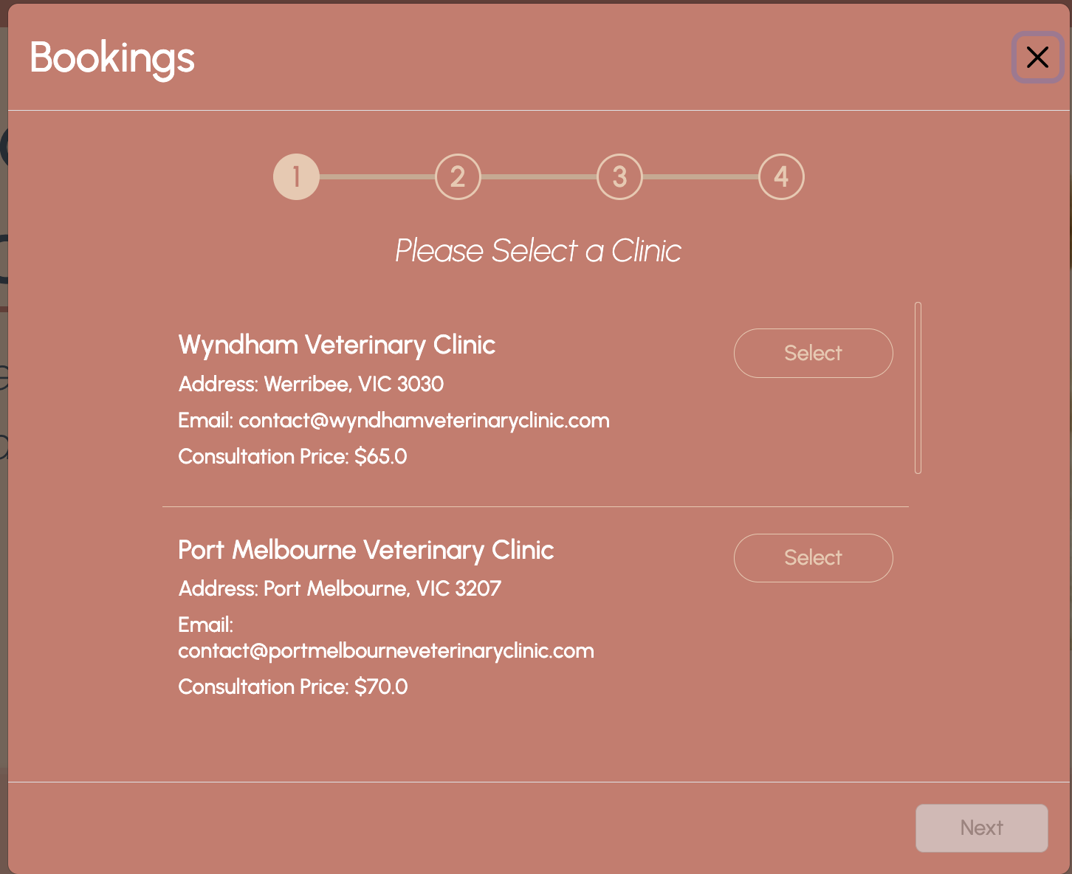
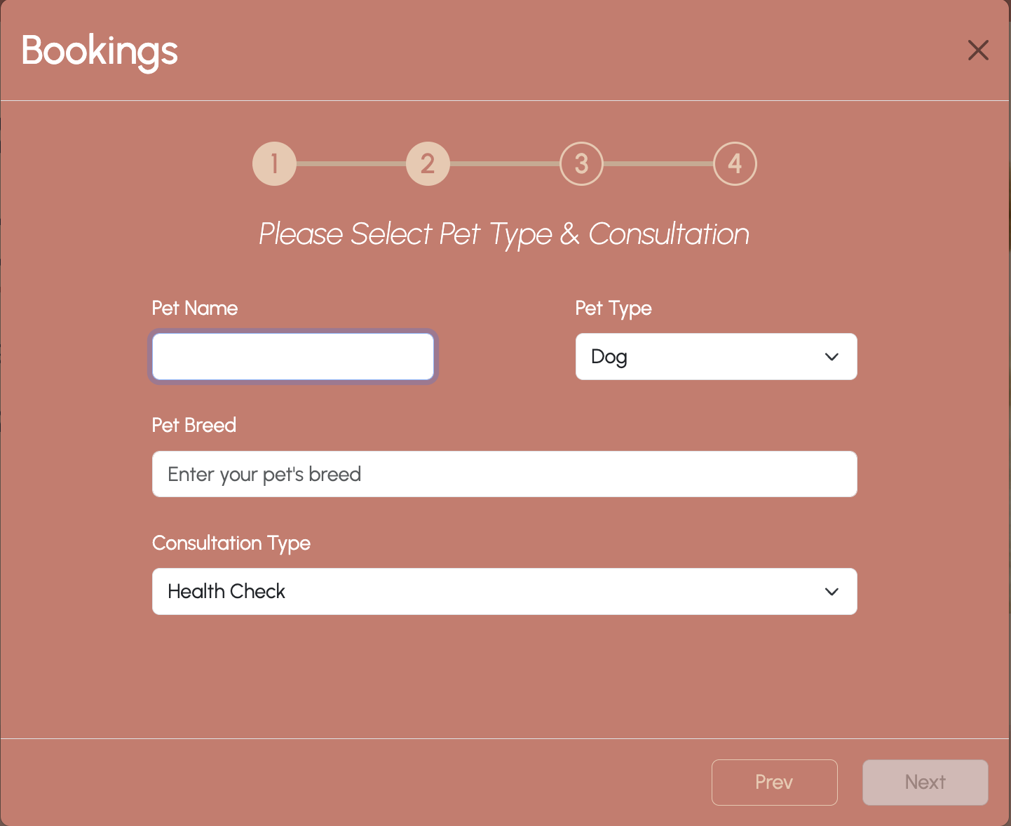
Appointment Booking - 1
Clinic Selection
Pet & Consultation Type

Slide 8
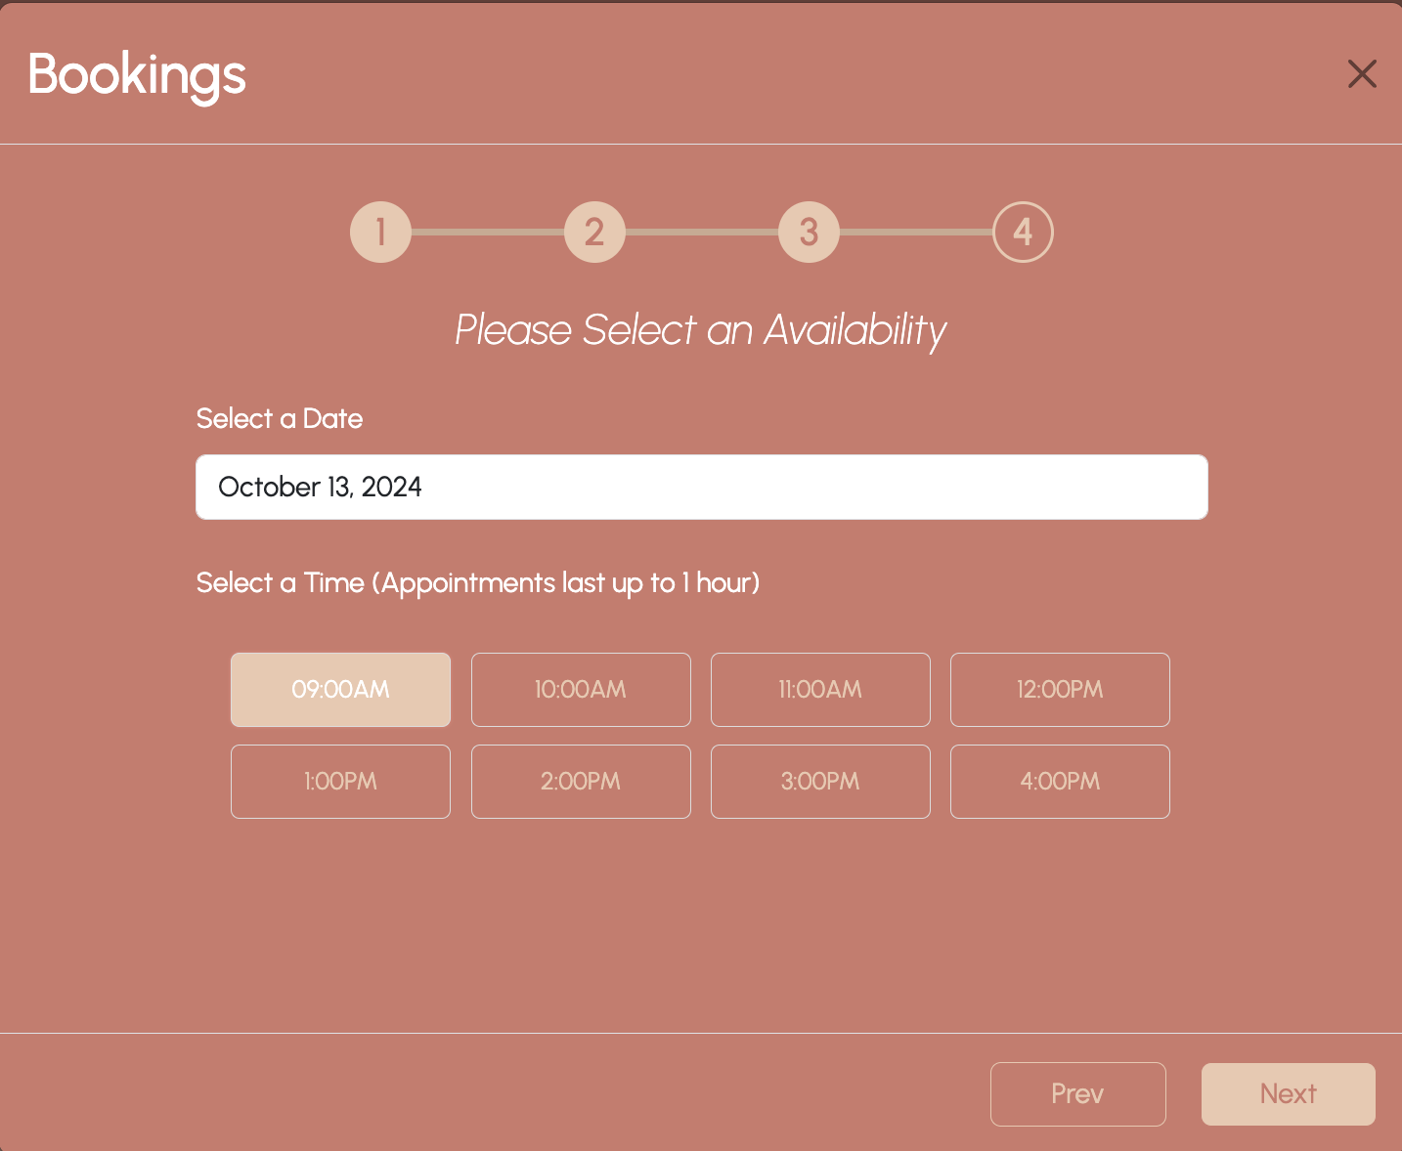
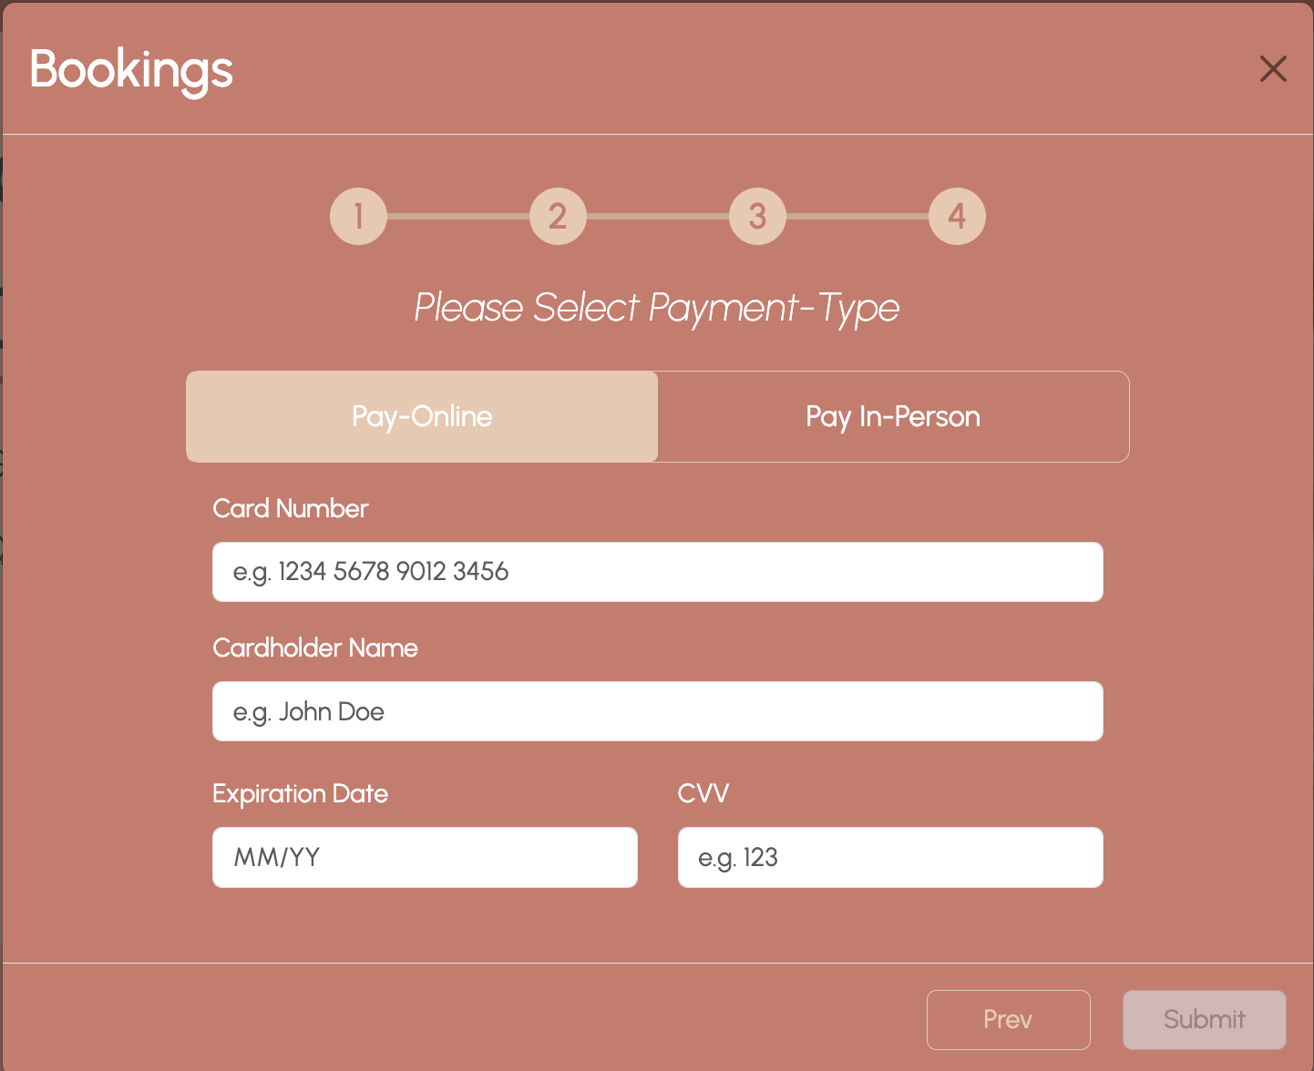
Appointment Booking - 2
Date & Time Selection
Payment

Slide 9
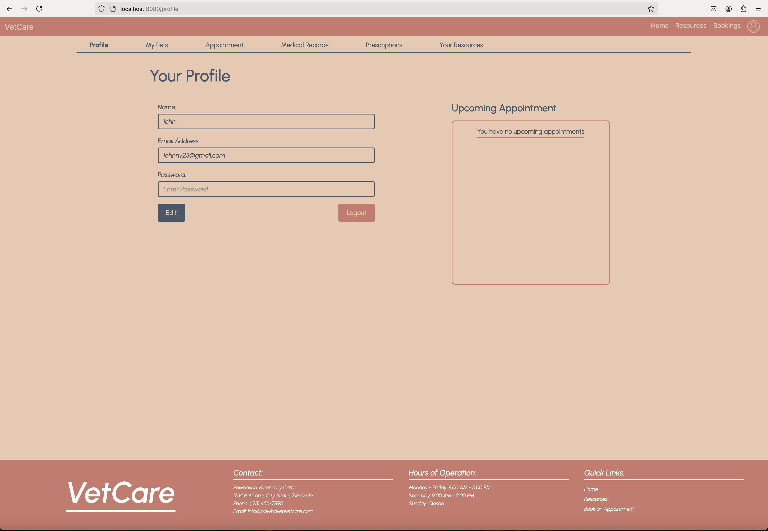
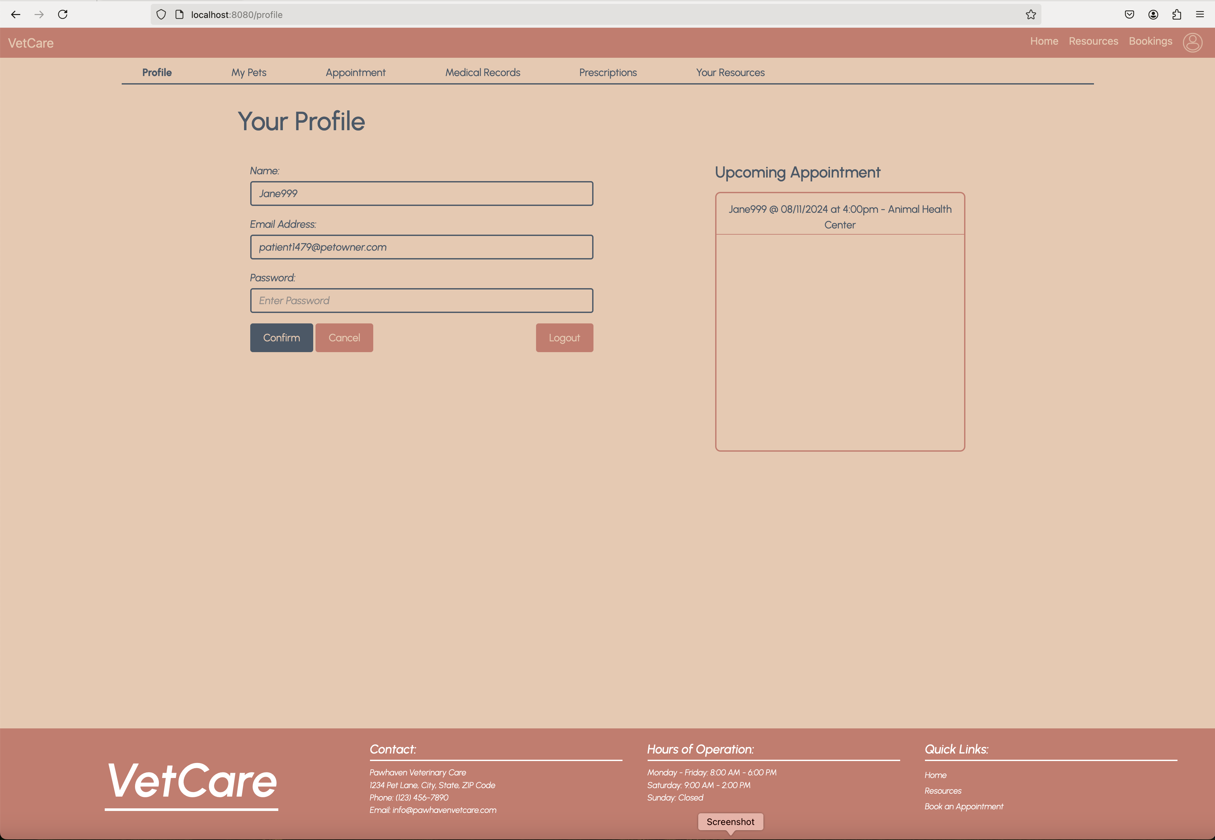
User Profile Display
Profile Information Display: Users can view their basic information, including name, email, and password, which is displayed in read-only mode by default.
Edit Profile: Users can edit their profile information by clicking the "Edit" button. This allows changes to the name, email, and password fields.
Save or Cancel Changes: After editing, users can either confirm the changes by clicking the "Confirm" button or discard the changes using the "Cancel" button.
Logout Option: A "Logout" button is available, allowing users to log out of their account at any time.
Upcoming Appointments: The profile page displays a list of upcoming appointments. If there are no upcoming appointments, a message is shown indicating that there are none.
Navigation to Other Tabs: The profile page includes a navigation bar allowing users to access various sections such as "My Pets," "Medical Records," "Prescriptions," and "Resources" directly from the profile.
Prepared By: Esmatullah Akhtary Student ID: s3941885

Slide 10
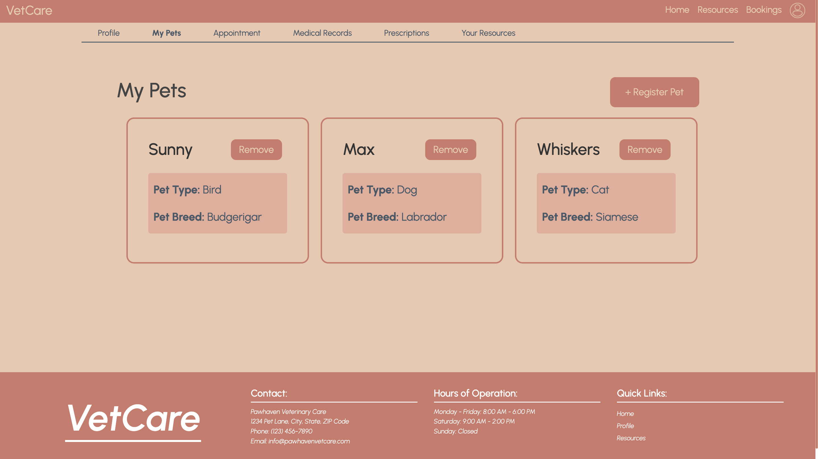
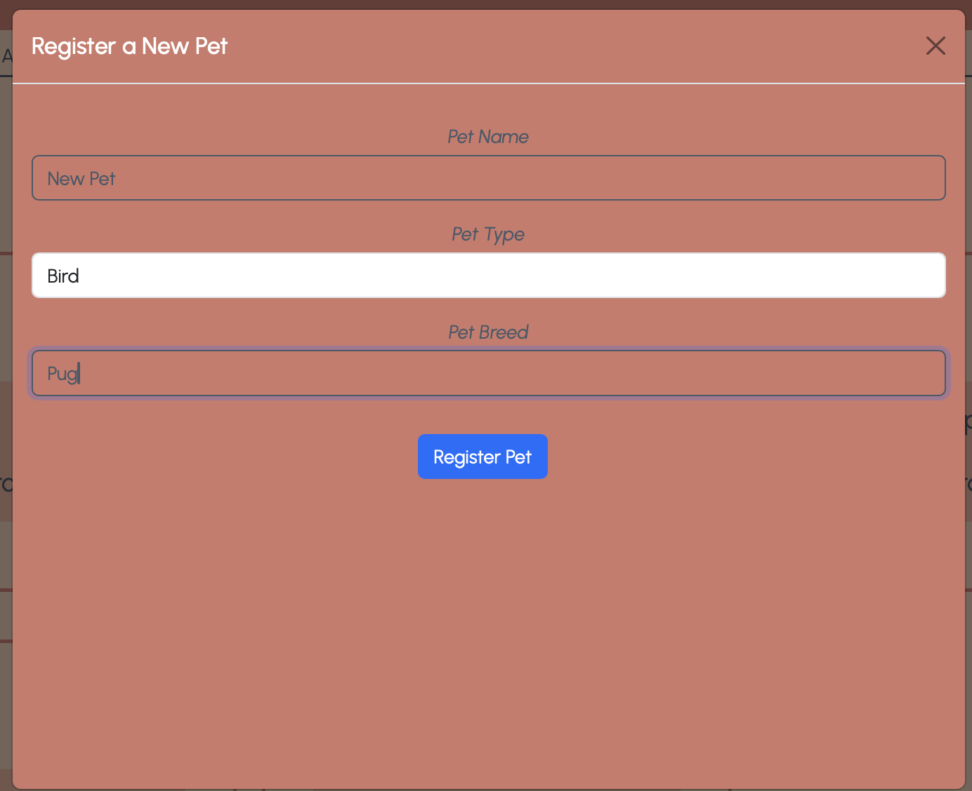
Pet registration
Overview | Key Features | Hidden Owner-ID | Why it’s interesting
Display and register pets functionality for the Vet Care Online system. Pets are shown in individual cards on the My Pets page, with Pet Name, Pet Type, and Pet Breed. Users can register new pets via a modal form. | Display Pets: - Dynamic pet display, fetching data from the database. - Pets are shown with essential details (Name, Type, Breed) in a clean, card layout. - Remove button allows deletion of pets, updating the list in real-time without page reloads. Register Pet: - Modal form with three mandatory fields: Pet Name, Pet Type, and Pet Breed. - User-friendly design with client/server-side validation. | Both the My Pets page and registration form use a hidden Owner ID. Ensures proper association of pets to owners in the database. Submitted with form data without user interaction, keeping the UI clean. | Scalable design for displaying pets dynamically and updating the UI in real-time. Modal enhances user experience with seamless pet registration (no page refresh). Hidden Owner ID maintains data integrity while simplifying the user interface.

Slide 11
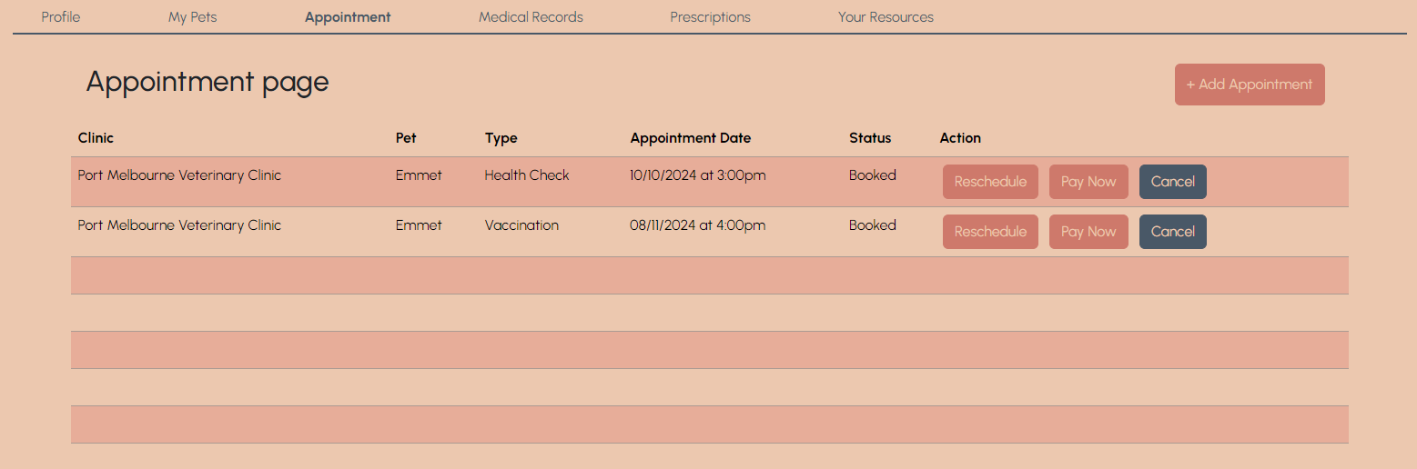
Manage Appointments - 1
Appointment Table

Slide 12
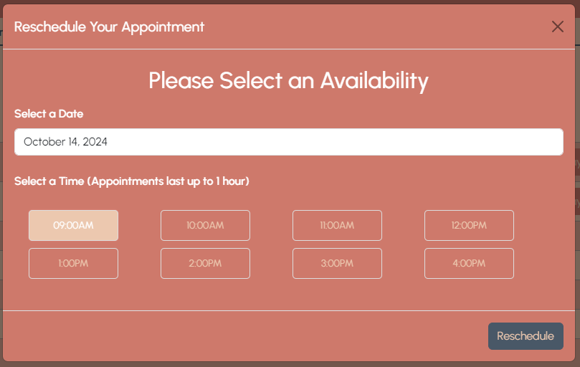
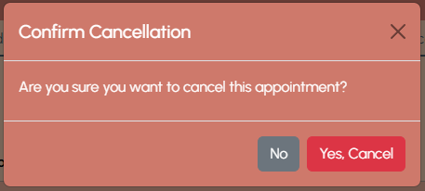
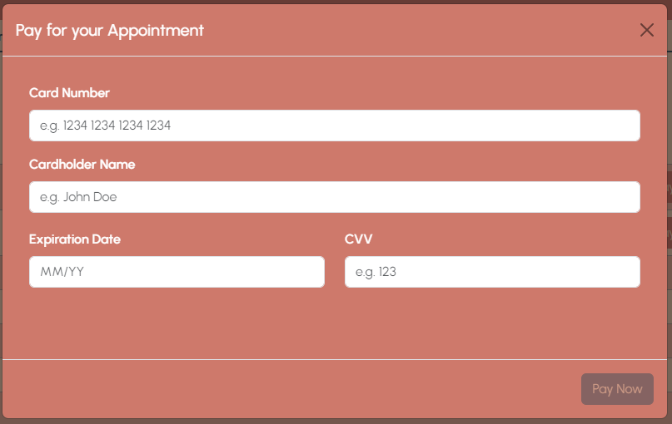
Manage Appointments - 2
Payment
Reschedule
Cancellation

Slide 13
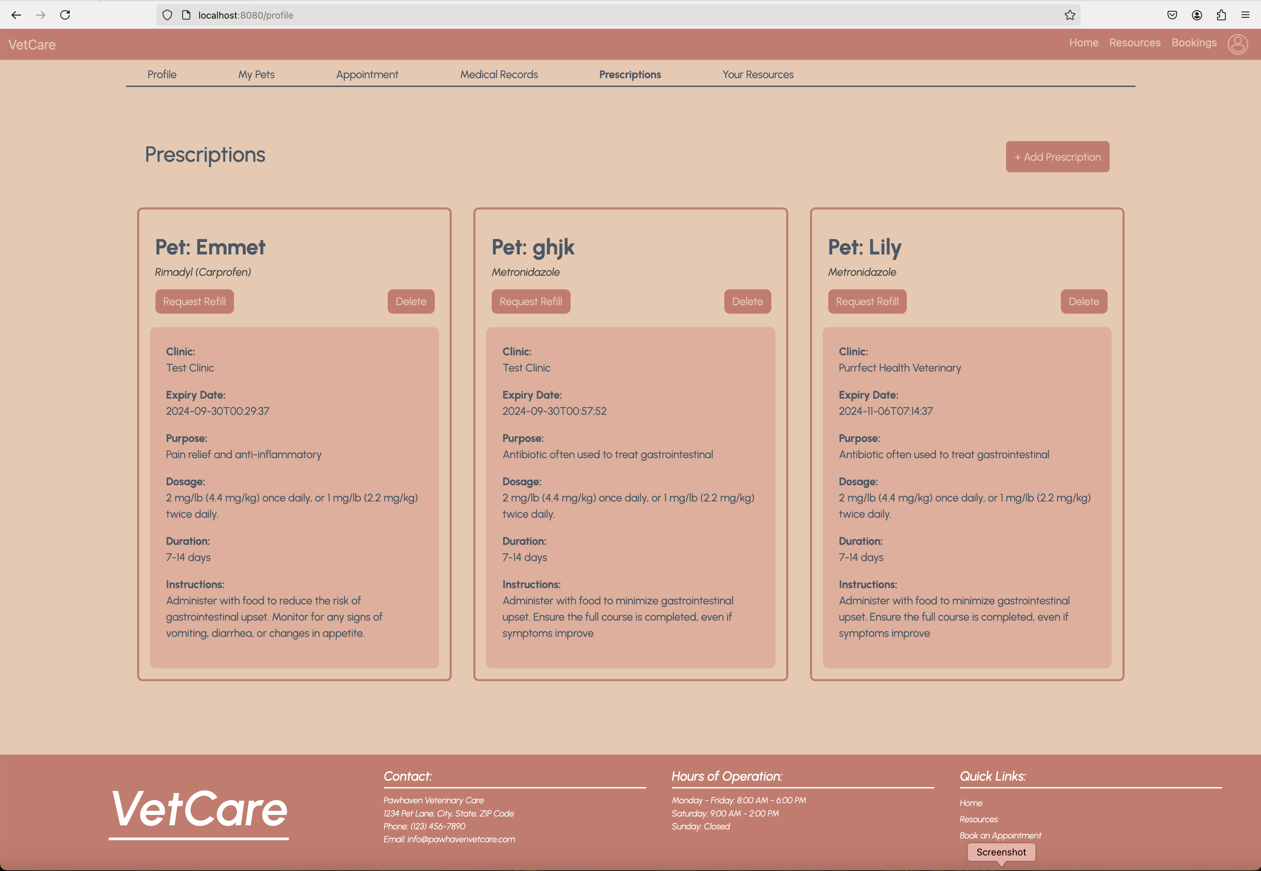
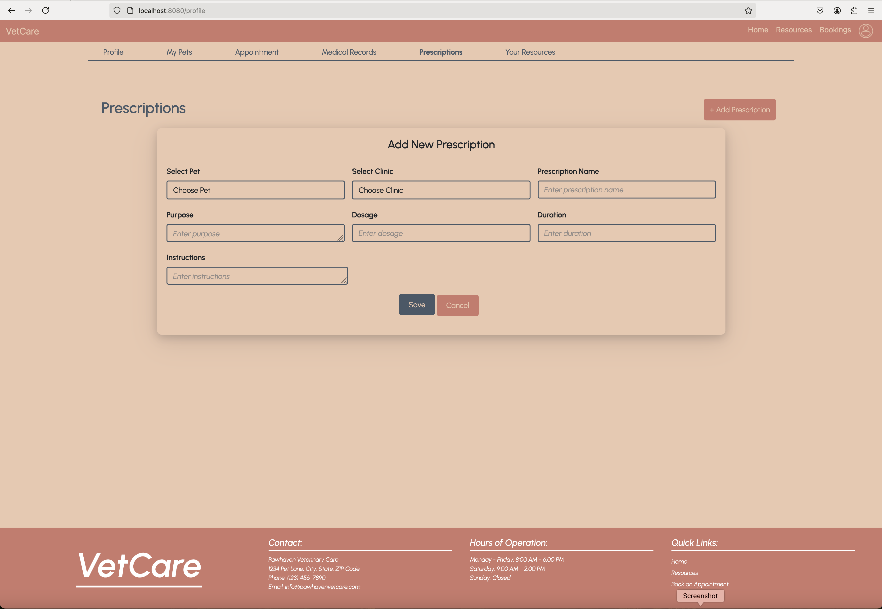
Prescriptions Display
Prescription Overview: When the user opens the prescription tab, they are presented with all active prescriptions.
No Prescriptions: If no prescriptions are available, a message will notify the user that there are no prescriptions listed.
Delete Prescription: Users can easily delete a prescription by clicking the "Delete" button on the respective prescription card.
Create Prescription: Users can create a new prescription by clicking the "Create Prescription" button.
Input Form: The prescription creation form includes dropdown menus for selecting a pet and clinic, along with fields for dosage, purpose, and instructions.
Issued and Expiry Date: The issued date (when the prescription is created) and the expiry date (which calculates the prescription’s validity) are automatically set in the backend during creation, ensuring consistency and reducing user input errors.
Cancel Creation: If the user changes their mind while creating a prescription, they can cancel the action.
No Registered Pets: If the user does not have any registered pets, a message will display, preventing prescription creation until a pet is registered.
Prepared By: Esmatullah Akhtary Student ID: s3941885

Slide 14
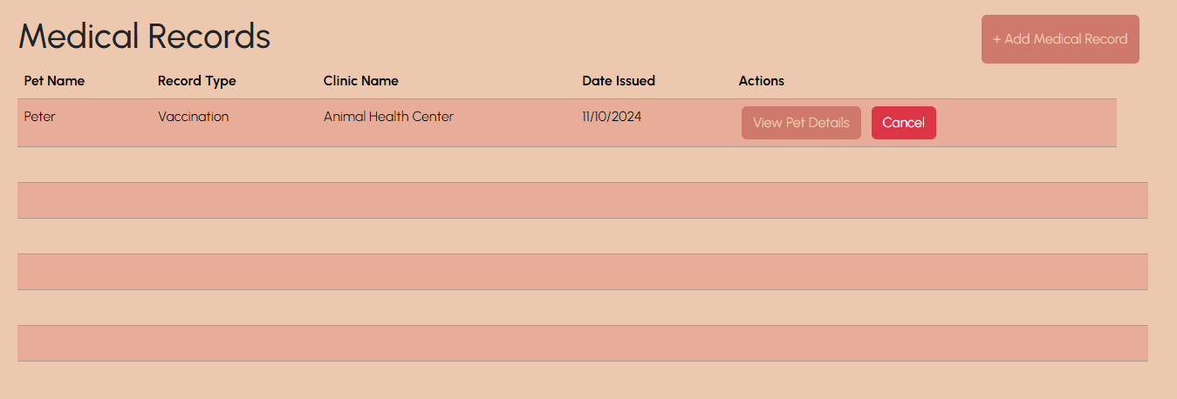
Manage Medical Records - 1
Medical Records Table

Slide 15
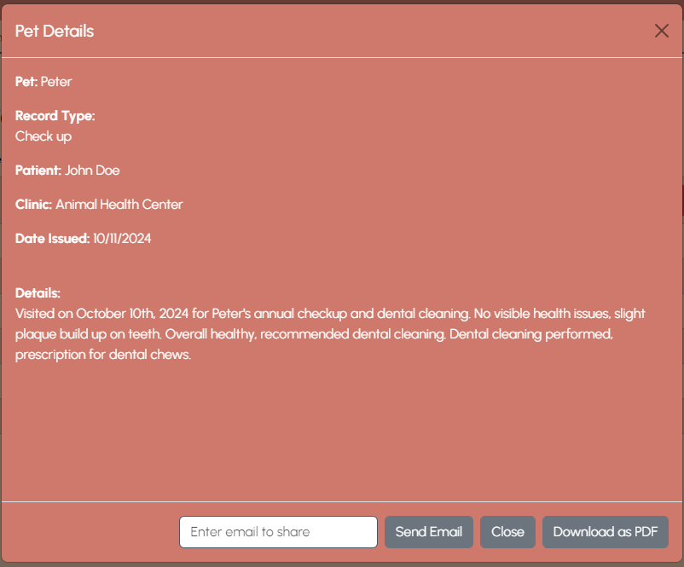
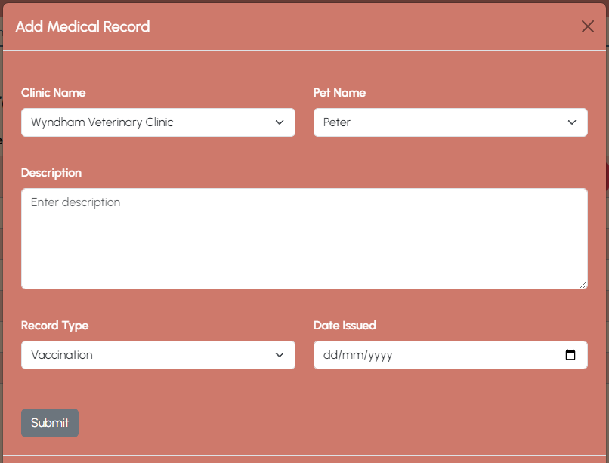
Manage Medical Records - 2
Medical Record
Add a Medical Record

Slide 16
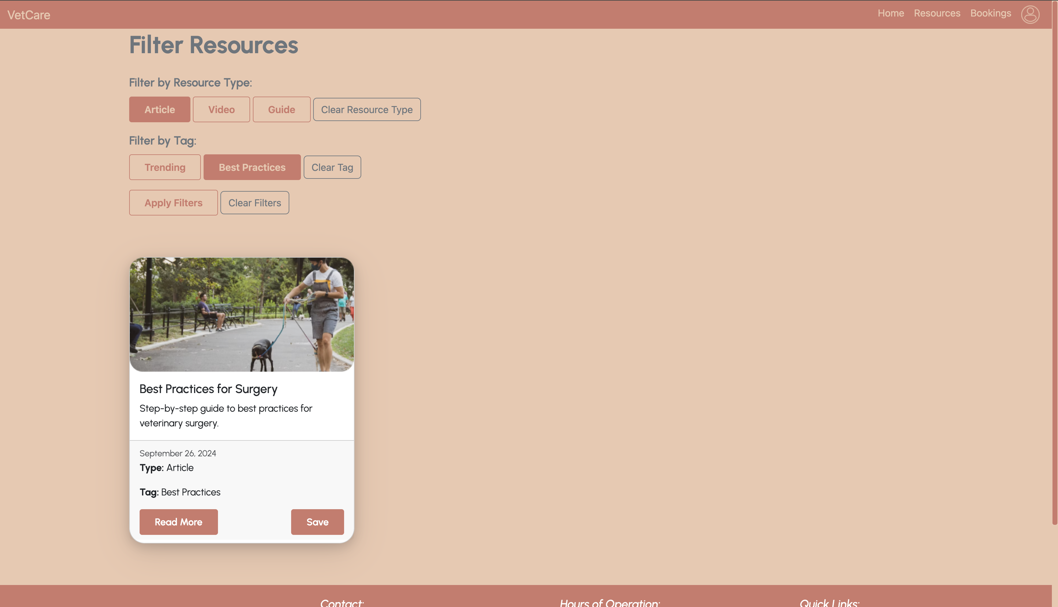
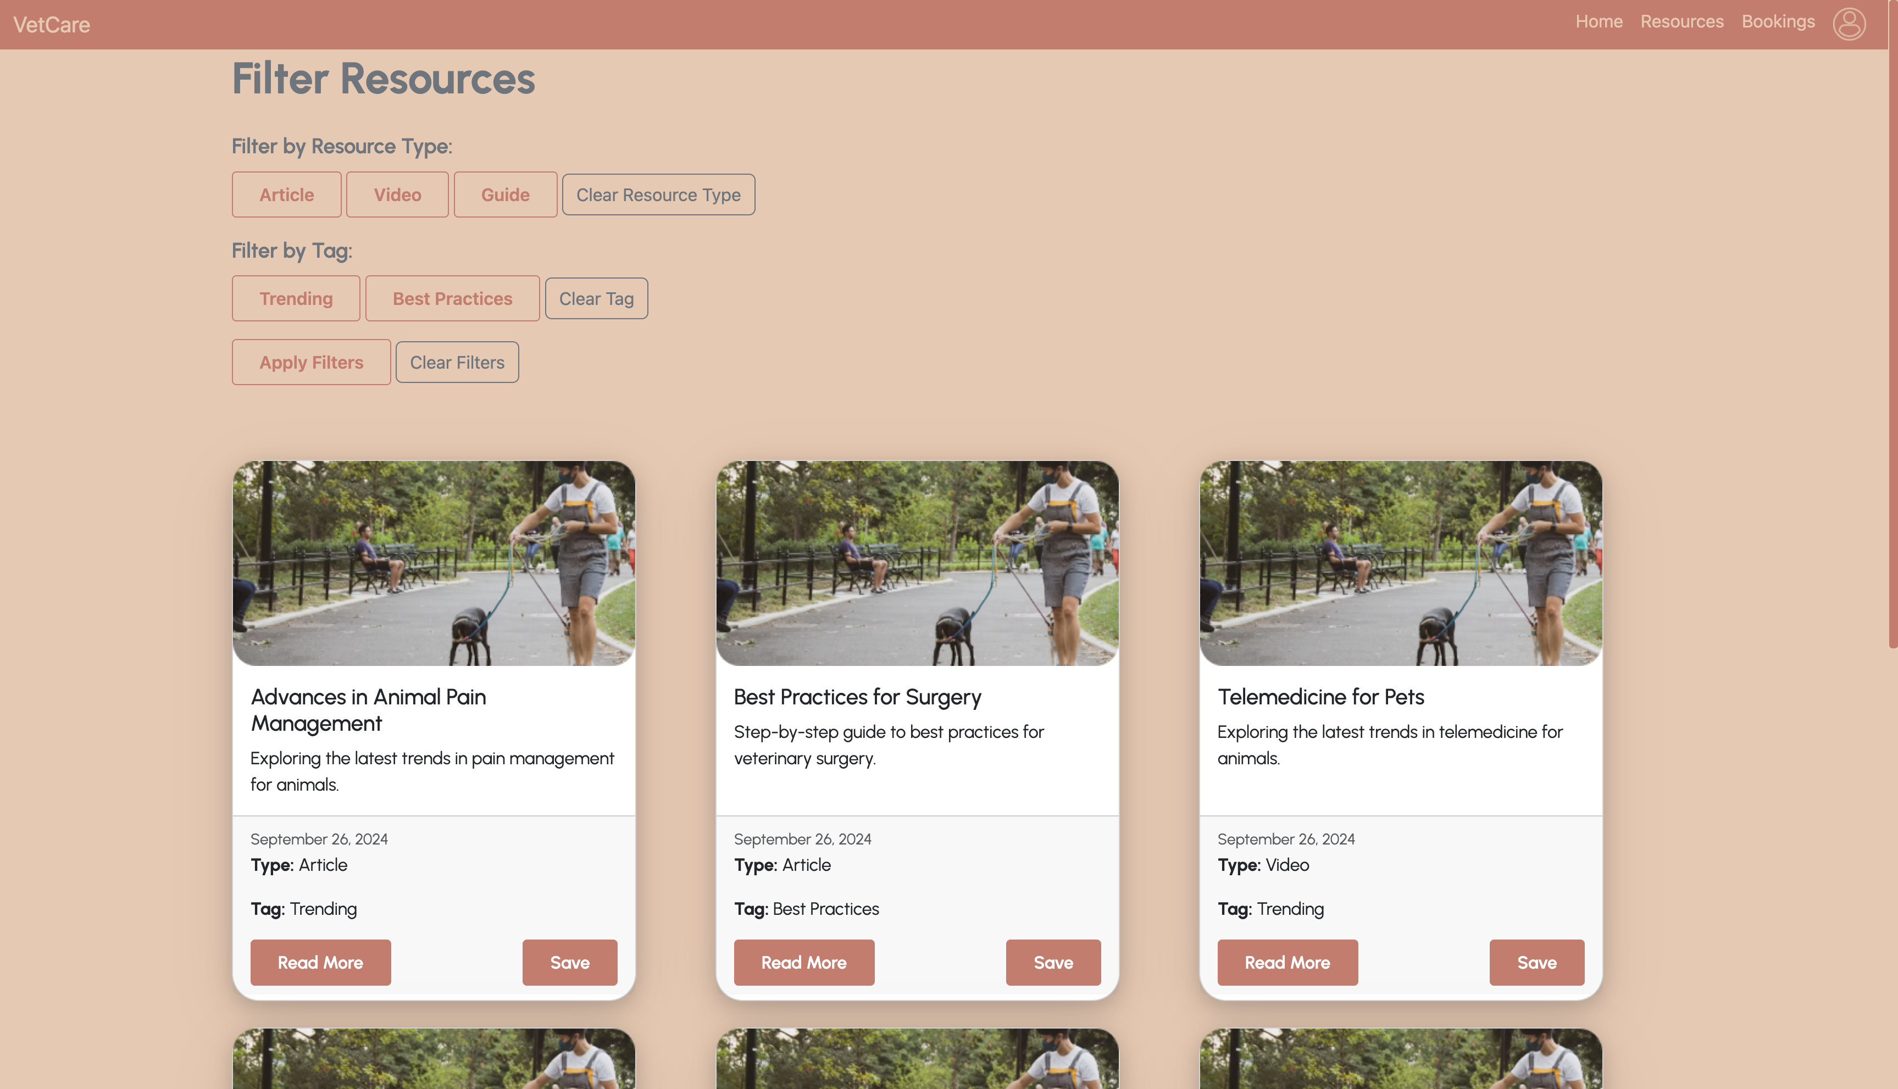
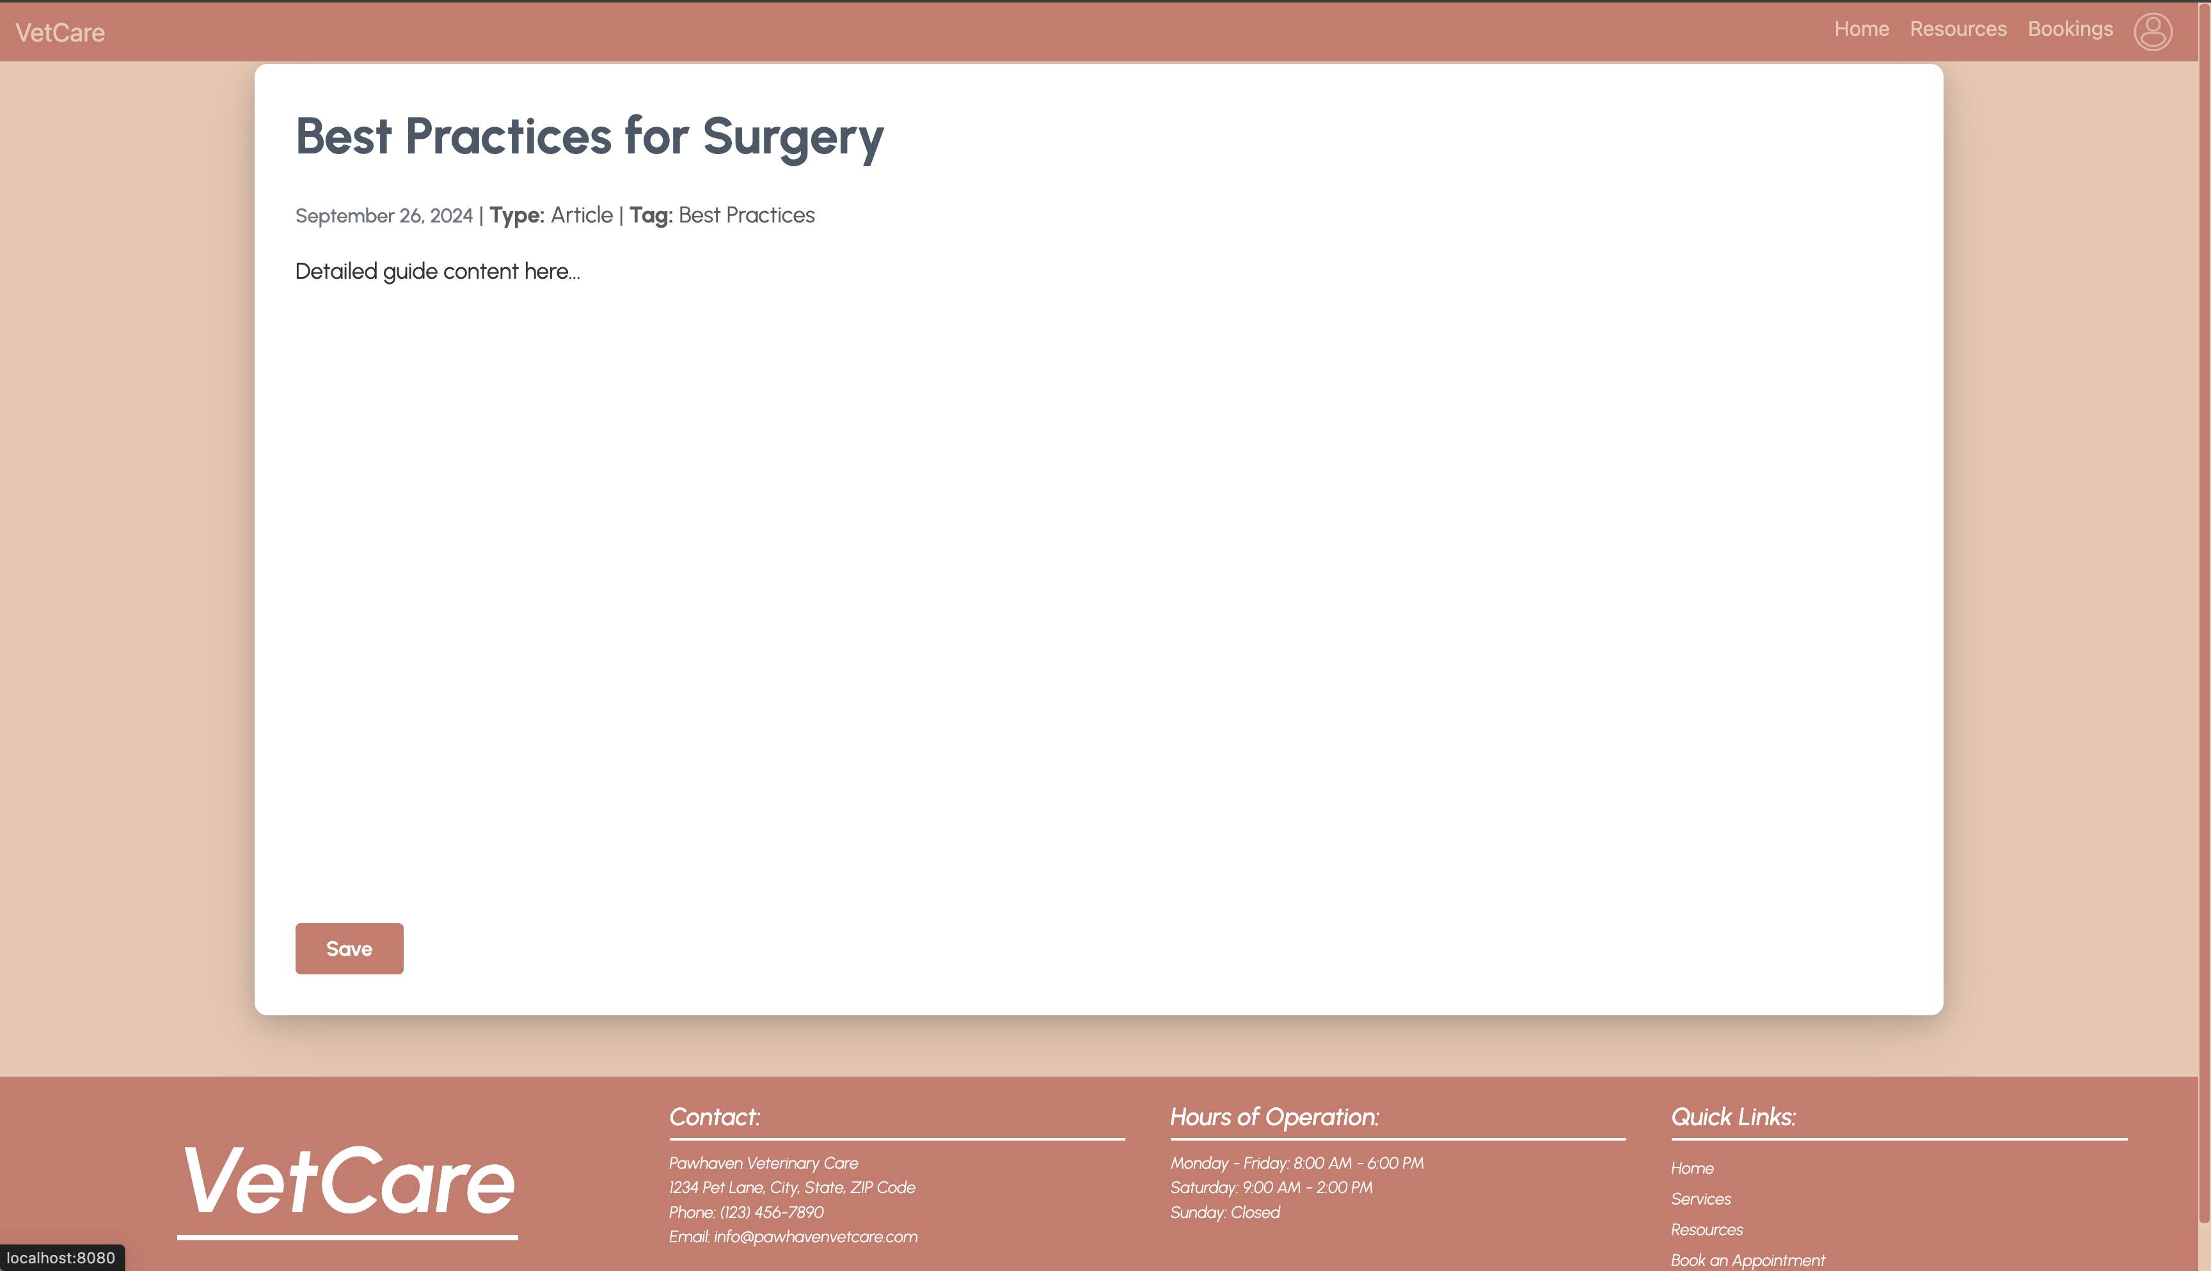
Educational Resources
Filtering feature to allow users to refine educational resources by type (e.g., Article, Video, Guide) and tag (e.g., Trending, Best Practices).
The filters are applied, and users can easily find relevant resources. Once filtered, resources are displayed with a "Read More" button that redirects the user to a detailed view of the resource.
The filtering is implemented by Thymeleaf and Spring Boot’s handling to dynamically display filtered results as cards.
A link to detailed resource page is provided by the Read More button.

Slide 17
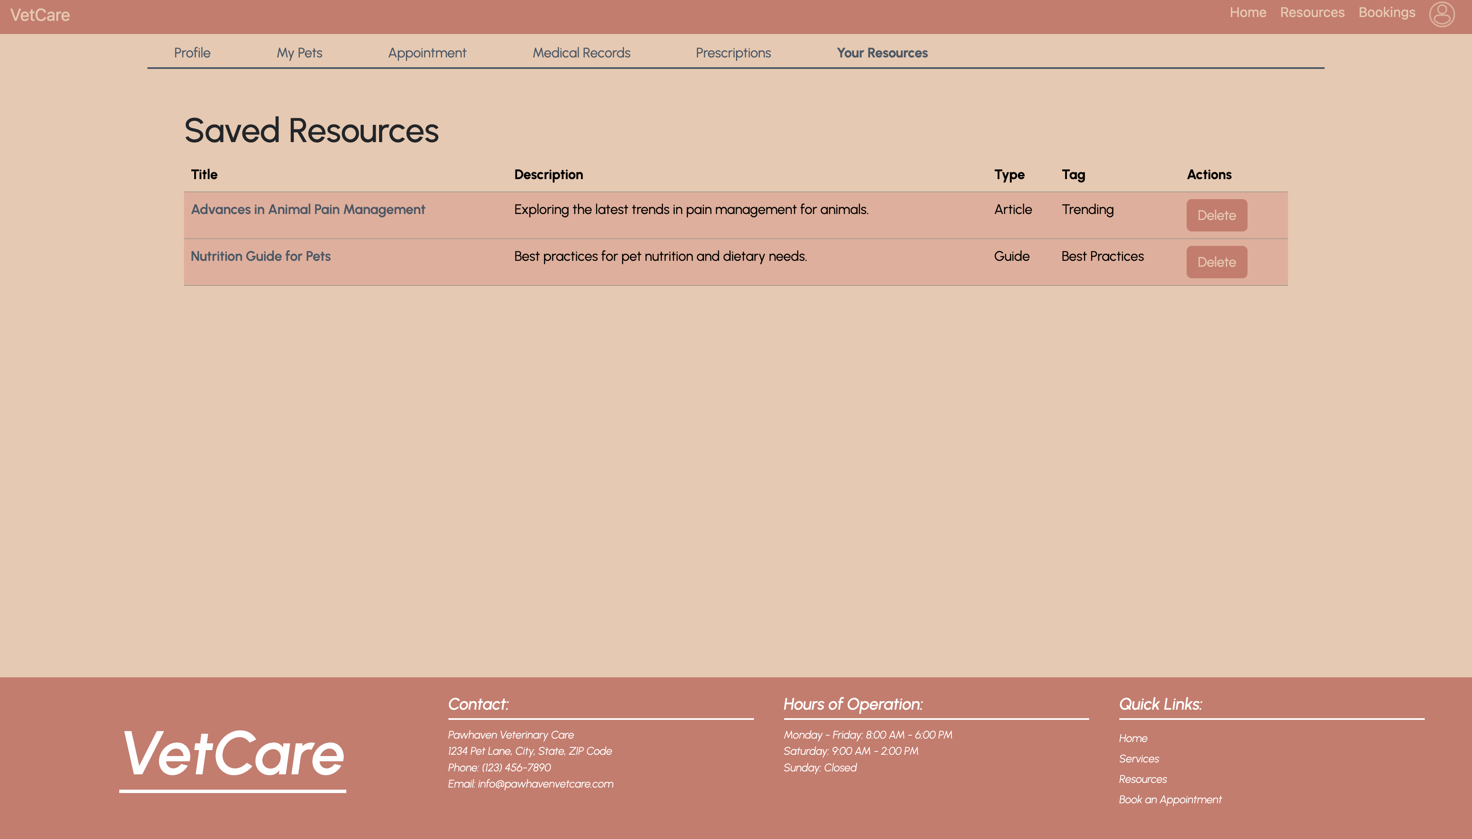
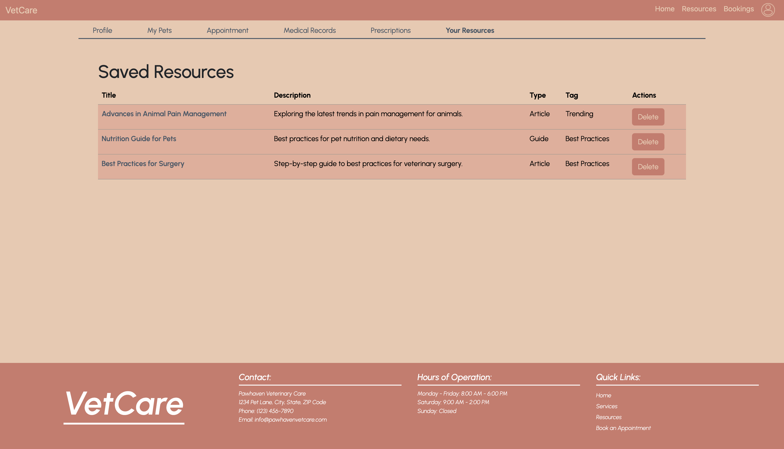
Save and Delete Features on the Profile Tab
Save Functionality
links to revisit saved resource page
Conditional Rendering
buttons visible only for logged in users
Manage Saved Resources
deletion

Slide 18
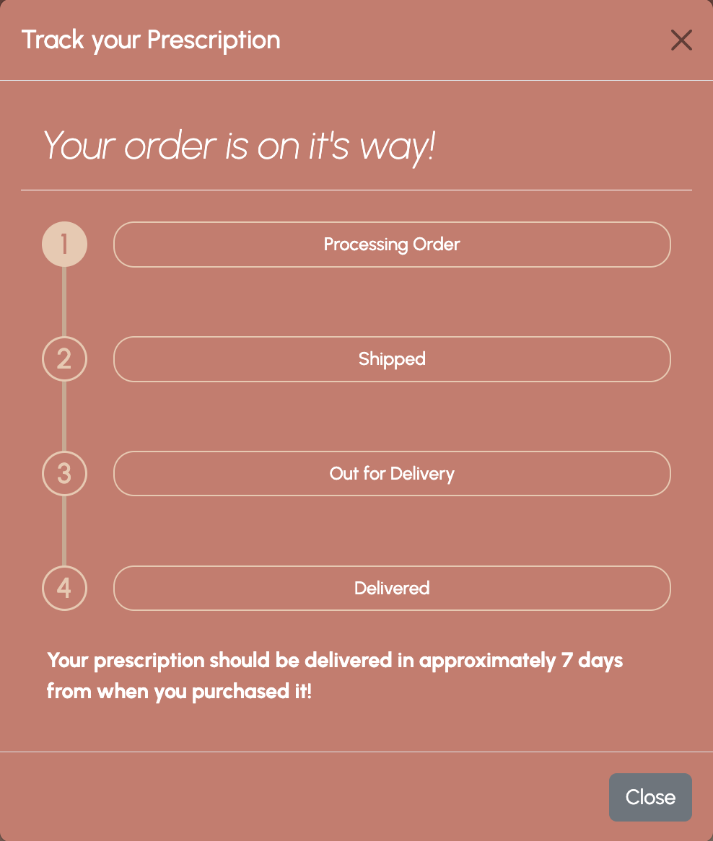
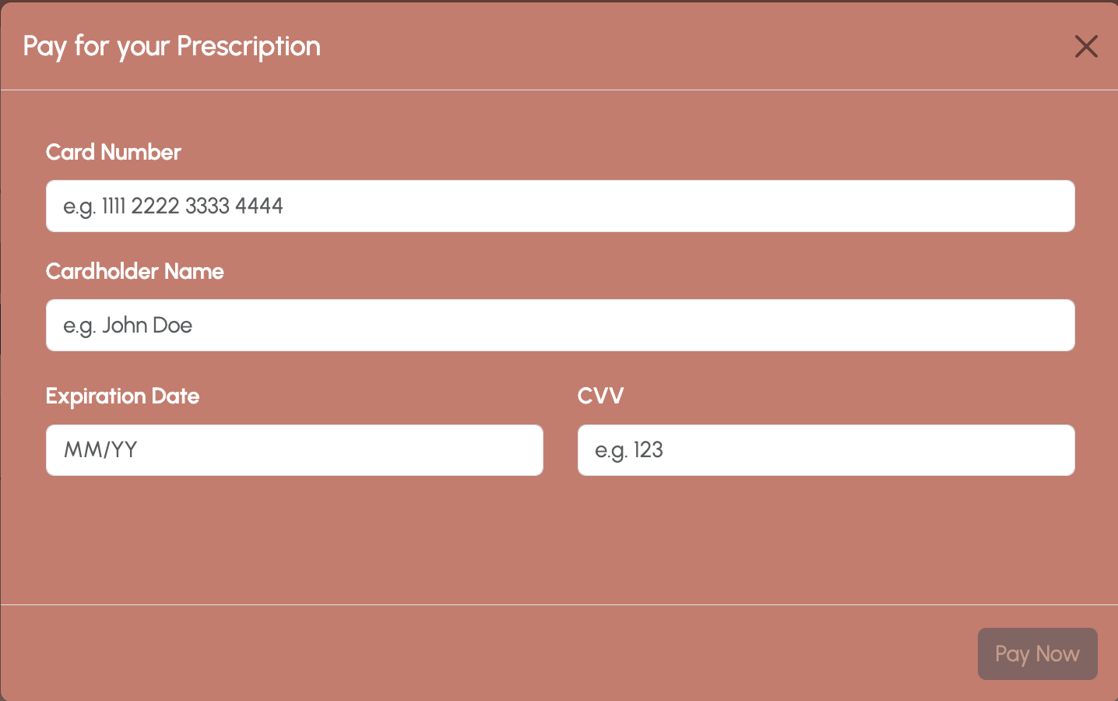
Prescription Tracking
Request Prescription
Track Prescription

Slide 19
Project Retrospective - 1
What worked well in the project ?
What could be improved on?
Teamwork: The collaboration between team members was smooth, and we communicated effectively to meet our goals.
Technology: The tools and technologies we used such act were efficient and helped streamline the process.
Communication: While communication was generally good, we could have improved our clarity on some requirements.
Time Management: We could improve our time management, especially in areas where we underestimated the time needed.

Slide 20
Project Retrospective - 2
What "surprised" you?
What did you learn?
Unforeseen Challenges: We were surprised by how complex the Scrum Process turned out to be. It took more time and resources than expected.
New Learning: Surprised by how much we learned about SpringBoot, Thymeleaf, etc in such a short time.
Technical Skills: We learned a lot about CI/CD workflow and the scrum process, which will help in future projects and future careers.
Problem-Solving: We gained better problem-solving skills, especially in troubleshooting with testing using JUnit and act.

Slide 21
Thank you
Team P09 - 05

